Slide 1

Project: Automatic calibration of a holographic acquisition rig
CITS4402
Ryan Christie (22500934), Colin Melville (23170781), Thomas Fell-Smith (23209005)

Slide 2
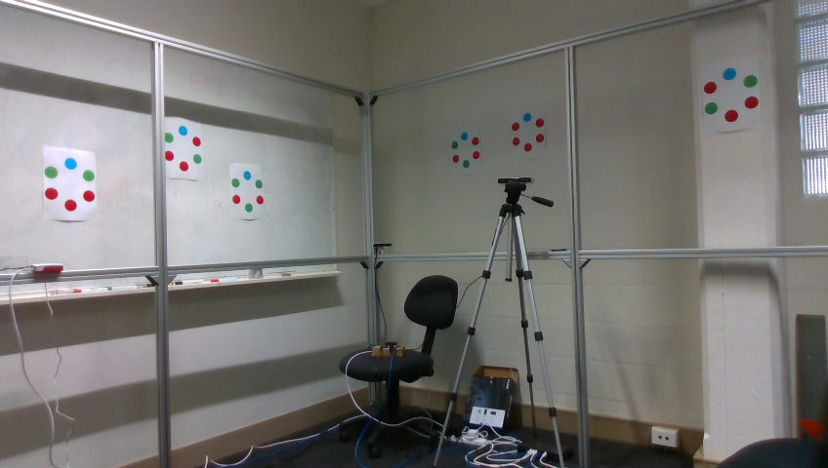
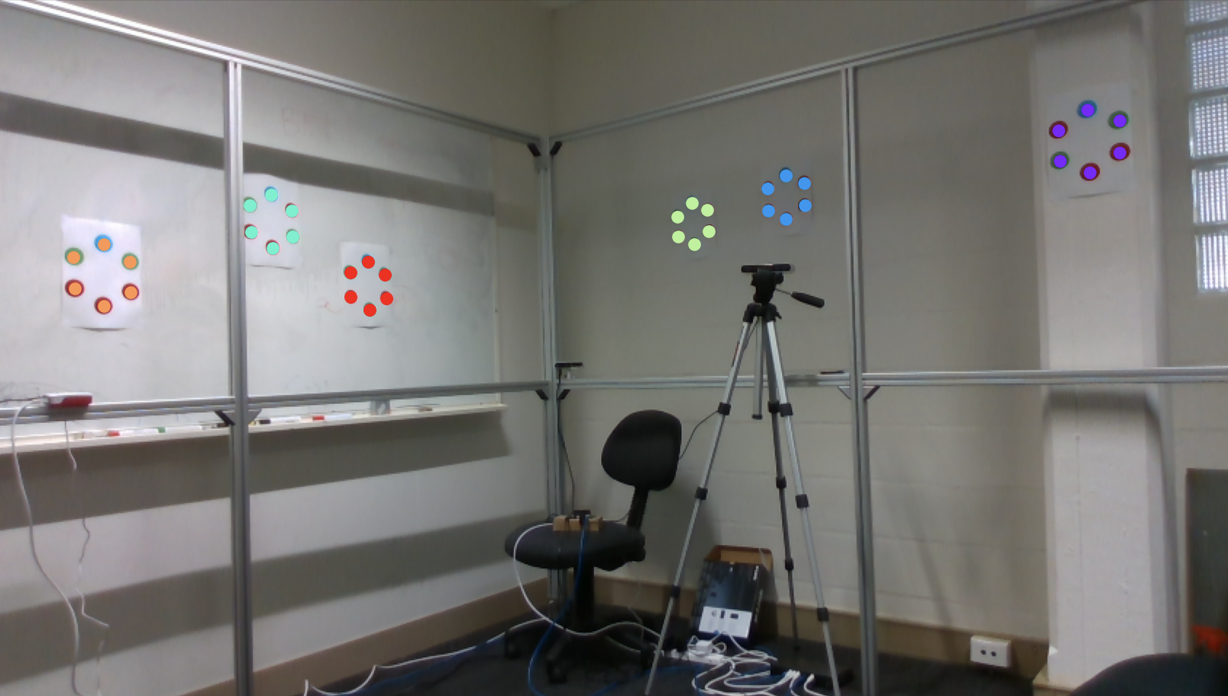
Task 1: The Rough Detection
From this:
Colour Segmentation
Connected Components Analysis
Point Refinement
Target Creation
To this:

Slide 3
Colour Segmentation
[200,110,79]

Slide 4
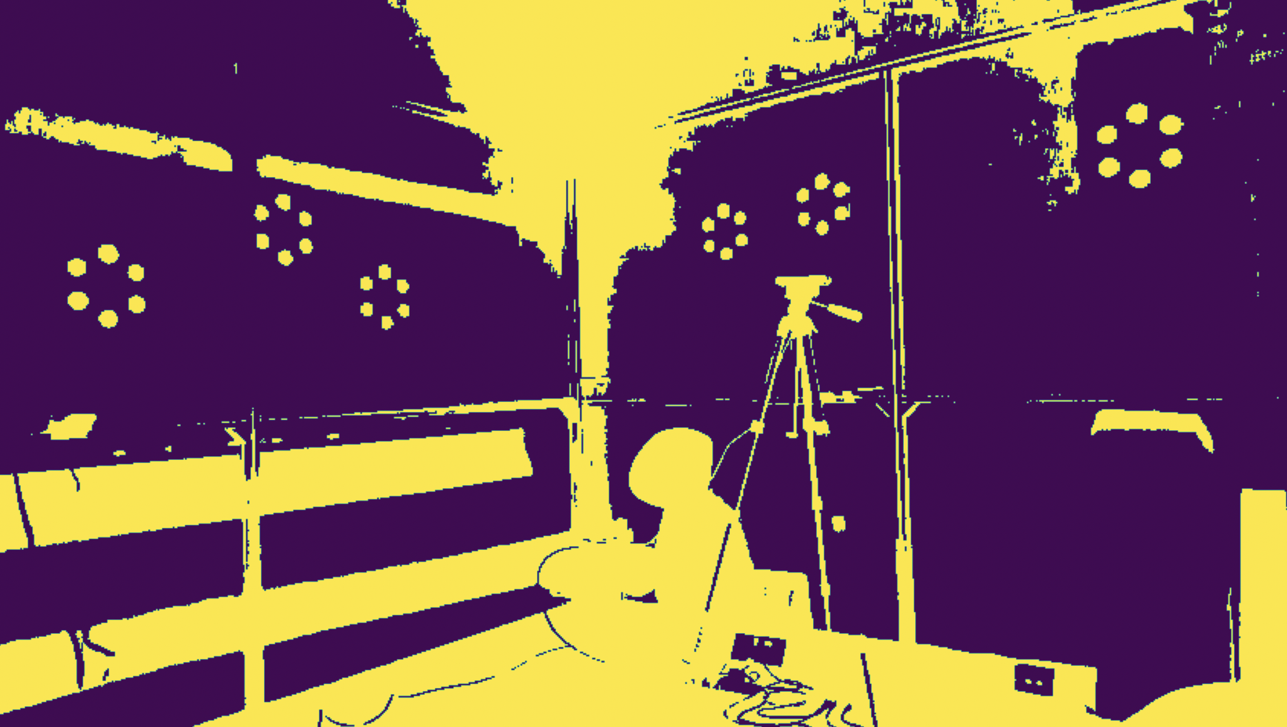
Colour Segmentation

Slide 5
Connect Component Analysis
from skimage.measure import label
1-connectivity (Rook)
[ ]
|
[ ]--[x]--[ ]
|
[ ]

Slide 6
Point Refinement
from skimage.measure import regionprops
region_size > threshold
region_size < threshold
region.eccentricity < threshold

Slide 7
Target Creation
Largest Residual > threshold
from skimage.measure import EllipseModel
Largest Residual

Slide 9

Task 2: Target Analysis and Refinement
Point Colour Analysis
Target Point Ordering & Naming
Target Centroid

Slide 10
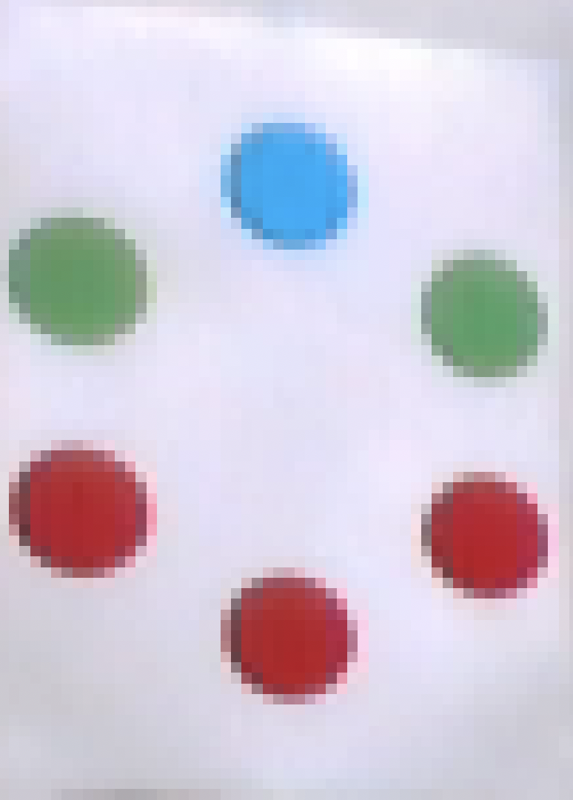
Point Colour Analysis
BLUE
GREEN
RED

Slide 11
Target Point Ordering & Naming
B
G
R
R
R
G

Slide 12
Target Centroid

Slide 14
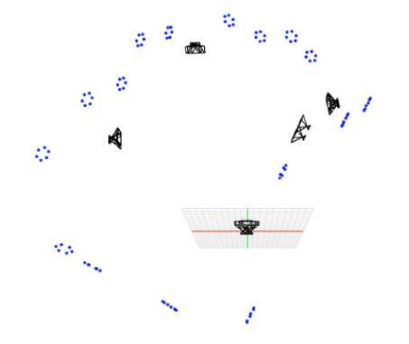
Task 3: Cameras Alignments
Steps involved:
Obtain 2D Target Coordinates
Perform Stereo Calibration
Calculate Camera projection matrices
Calculate 3D Target coordinates
Calculate Target and Camera poses
Incorporate global adjustment solver *Unimplemented*
Plot poses *Unimplemented*
Figure 1. Local Reference Camera View and Targets

Slide 15
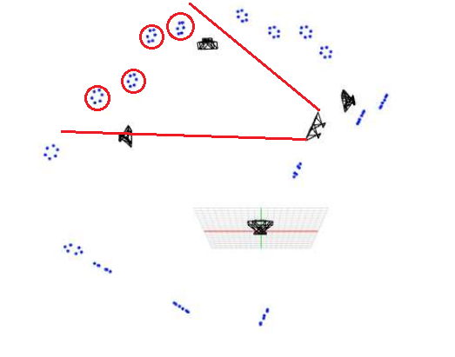
The Local Reference Frame
Steps:
We first needed to get the 2D coordinates of the targets in view, which we were able to do using Task 1 code.
Then we stereo calibrated the cameras to obtain their projection matrices.
Using these projection matrices we calculated the 3D coordinates of the targets.
Using SolvePnP, we determined the target and camera poses.
Figure 2. Local Reference Camera View and Targets

Slide 16
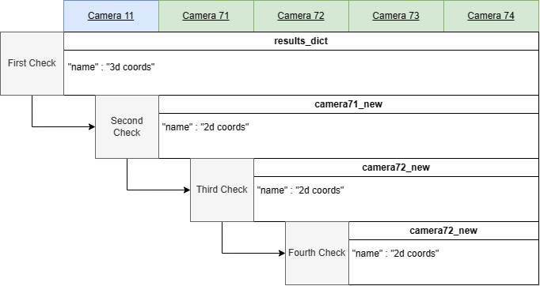
Referencing and Adding Targets: Core Principle
Example: Camera 74
Do we already have their 3D coordinates?
If not, is it in the set of targets found by camera 71?
If not, is it in the set of targets found by camera 72?
If not, is it in the set of targets found by camera 73?
Figure 3. Iterative Checking

Slide 17
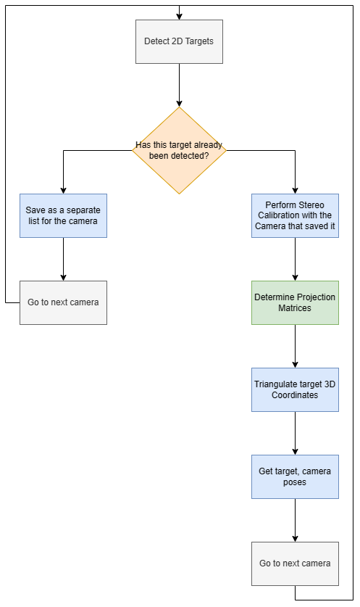
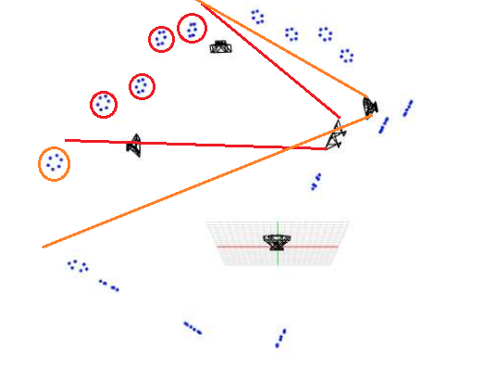
The Iterative Process
Figure 2. New Camera View and Targets

Slide 18
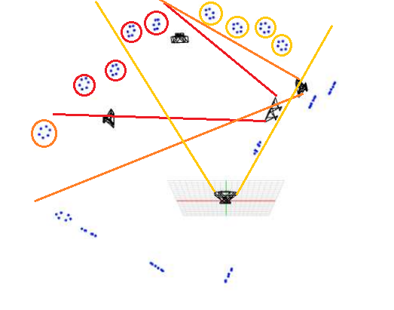
The Iterative Process
Figure 2. New Camera View and Targets

Slide 19
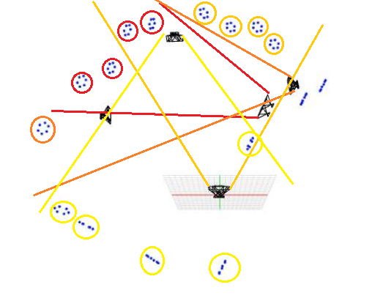
The Iterative Process
Figure 2. New Camera View and Targets

Slide 20
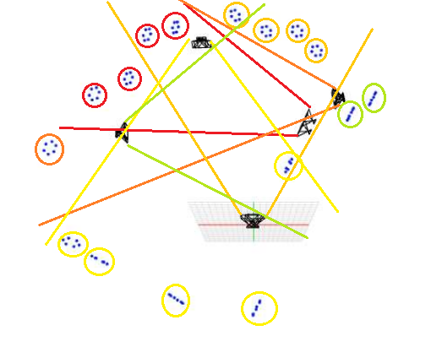
The Iterative Process
Figure 2. New Camera View and Targets

Slide 21
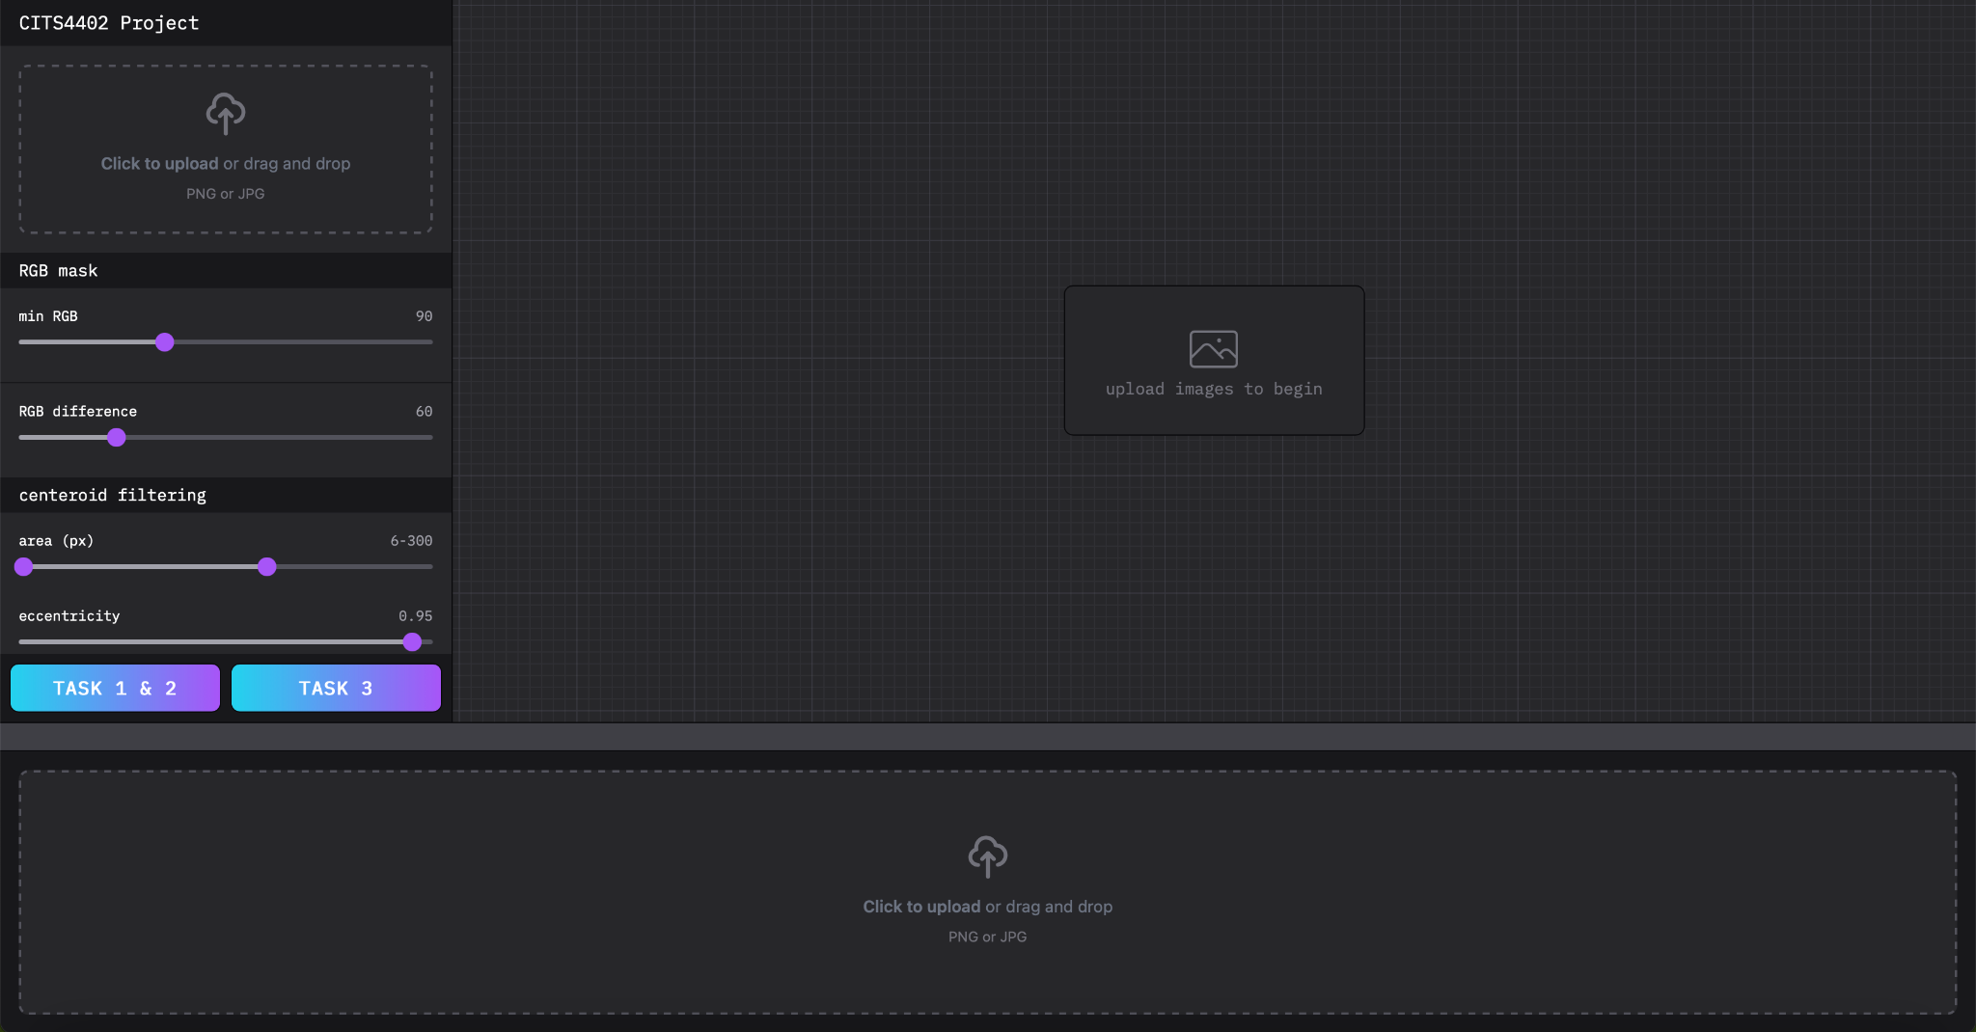
Web Application - Demonstration
http://localhost:5173/

Slide 22
References
Figures 1 and 2 can be found in the Thesis Extract

